Slide 1
Convolutional Neural Networks Lecture 2
October 1st, 2018

Slide 2

Structure in images is (often) local and repeated
Fully connected network would have to learn each of these
independently

Slide 3
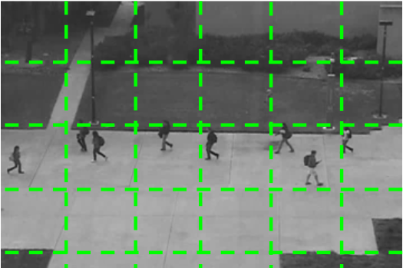
Multilayer Perceptrons (or fully-connected networks) look for patterns across all nodes in the layer that feeds into it
This is because each node receives input from every node in the layer before it
CNNs only look for features in small neighborhoods
e.g. 15x15, 11x11, 9x9, 7x7, 3x3, etc.

Slide 4
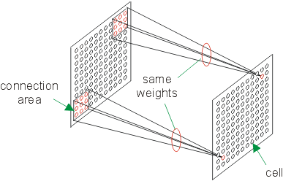
Weight Sharing

Slide 5
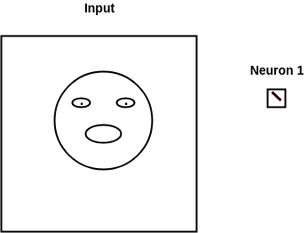
Simple Example

Slide 6
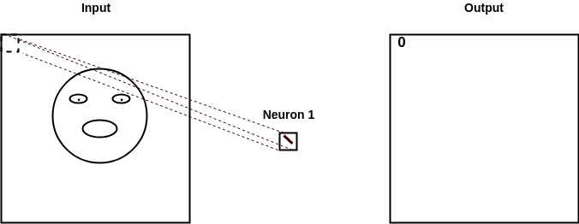
Simple Example

Slide 7
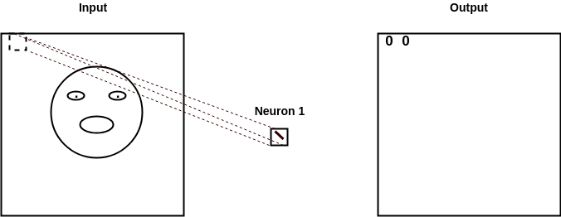
Simple Example

Slide 8
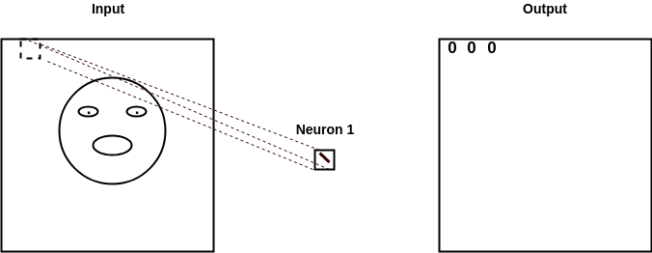
Simple Example

Slide 9
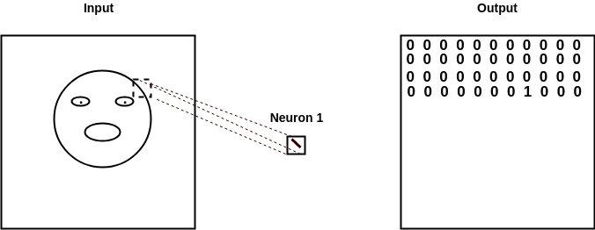
Simple Example

Slide 10
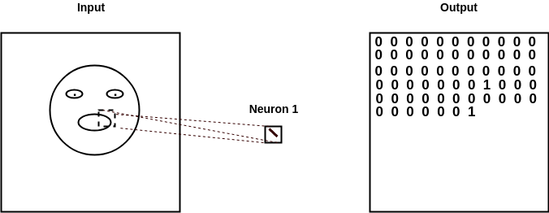
Simple Example

Slide 11
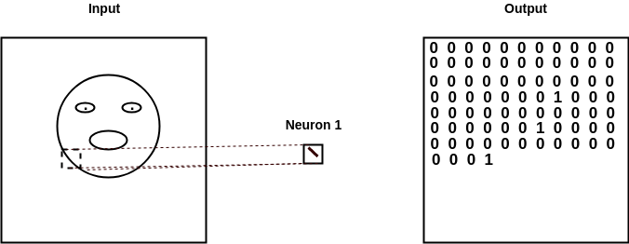
Simple Example

Slide 12
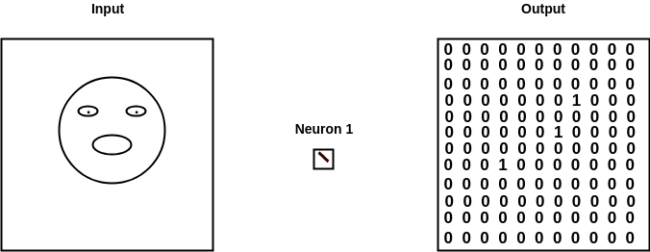
Simple Example
In reality, the output will contain continuous values. The higher the number, the more that neuron found what it was looking for.

Slide 13
Each neuron learns to look for something that can help the network put the input into the correct class
The features they look for in the first few layers are very simple
e.g. lines, edges
Each successive layer looks for combinations of features in the previous layer’s output
e.g. neurons in first layer will look for edges in input image and mark where they found their specific edge
Next, neurons in second layer will look at each neuron’s map from the first layer (i.e. where they found their specific edge) and begin to look for combinations of those
e.g. squares, circles, etc.
At high layers, single nodes begin to look for complex things like faces, cars, certain animals, etc.

Slide 14
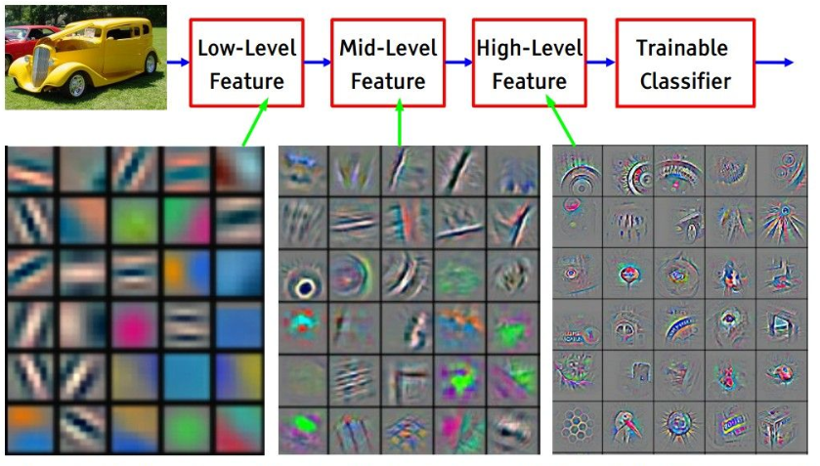

Slide 15
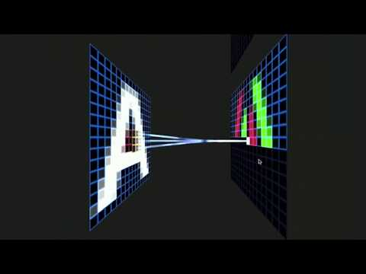
https://youtu.be/f0t-OCG79-U

Slide 16
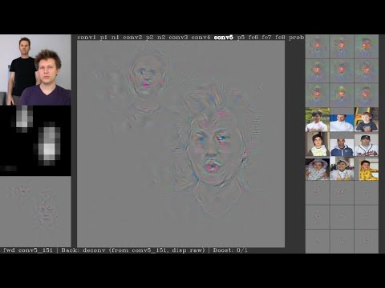
https://youtu.be/AgkfIQ4IGaM

Slide 17
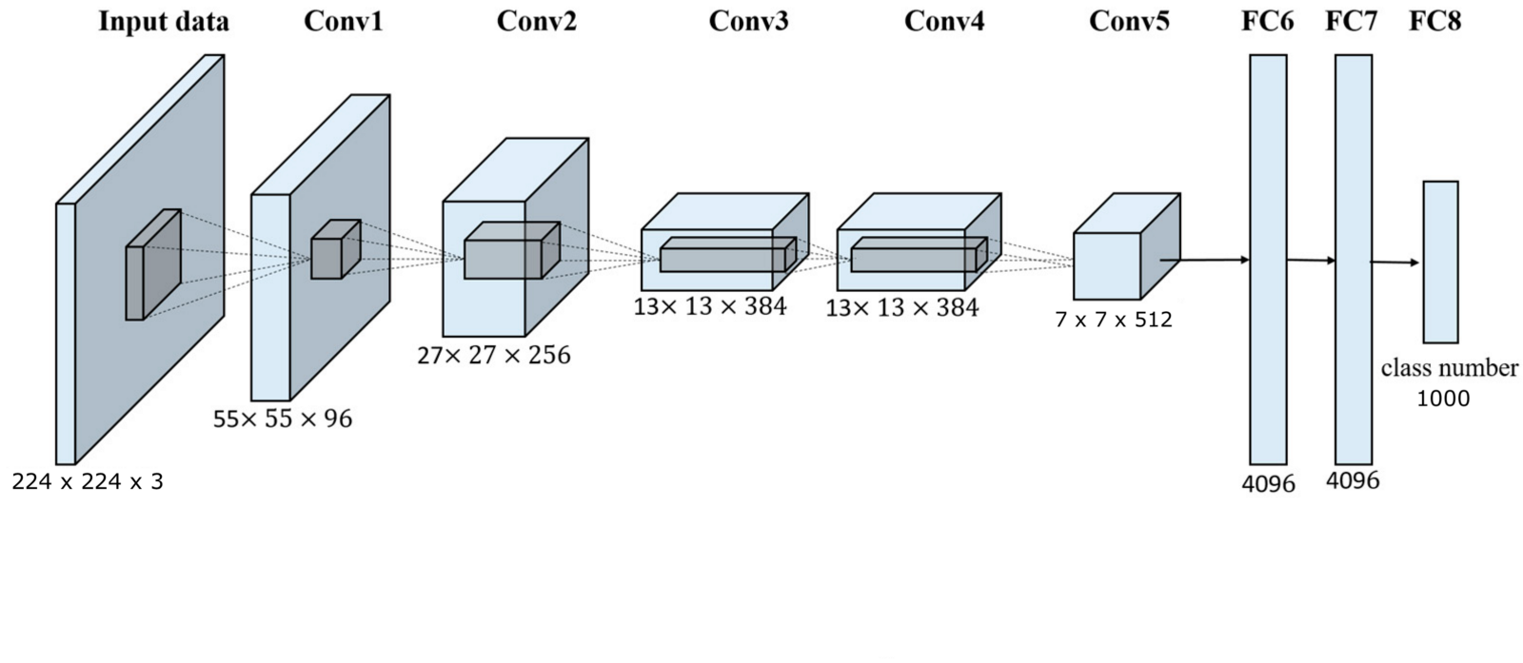
General CNN Architecture

Slide 18
HW 3
Watch the lecture here and describe the following and each one’s function in a CNN with at least 3 full sentences each:
Filter
Feature
Feature Map
Pooling
https://www.youtube.com/watch?v=ghEmQSxT6tw&t=987s

